Slide 1

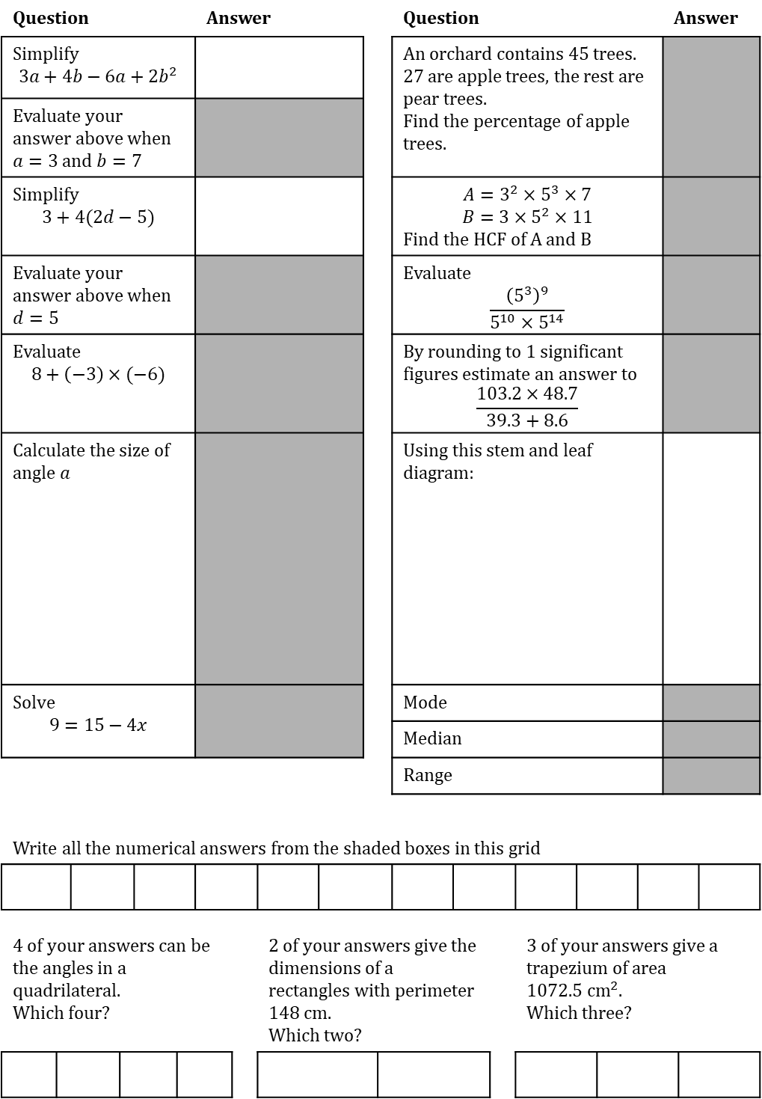

TASK
Date:
Question |  |  |  |  |  | Answer |  |  |  |  |  | Question |  |  |  |  | Answer |  | Answer
Simplify $$3a+4b−6a+2b^{2}$$ |  |  |  |  |  |  |  |  |  |  |  | An orchard contains 45 trees. 27 are apple trees, the rest are pear trees. Find the percentage of apple trees.
Evaluate your answer above when $a=3$ and $b=7$
Simplify $$3+4(2d−5)$$ |  |  |  |  |  |  |  |  |  |  |  | $$A=3^{2}×5^{3}×7$$ $$B=3×5^{2}×11$$ Find the HCF of A and B
Evaluate your answer above when $d=5$ |  |  |  |  |  |  |  |  |  |  |  | Evaluate $$\frac{{\left(5^{3}\right)}^{9}}{5^{10}×5^{14}}$$
Evaluate $$8+\left(−3\right)×(−6)$$ |  |  |  |  |  |  |  |  |  |  |  | By rounding to 1 significant figures estimate an answer to $$\frac{103.2×48.7}{39.3+8.6}$$
Calculate the size of angle $a$ |  |  |  |  |  |  |  |  |  |  |  | Using this stem and leaf diagram:
Solve $$9=15−4x$$ |  |  |  |  |  |  |  |  |  |  |  | Mode
 |  |  |  |  |  |  |  |  |  |  |  | Median
 |  |  |  |  |  |  |  |  |  |  |  | Range
Write all the numerical answers from the shaded boxes in this grid
4 of your answers can be the angles in a quadrilateral. Which four? |  |  |  |  |  |  |  | 2 of your answers give the dimensions of a rectangles with perimeter 148 cm. Which two? |  |  |  |  |  |  | 3 of your answers give a trapezium of area $1072.5 {\text{cm}}^{2}$. Which three?
1 | 2 | 3 | 4
2 | 1 | 1 | 6 | 7 | 9
3 | 0 | 4 | 7
4 | 2 | 6 | 9
5 | 1
1 | 2 | means 12kg
$$35°$$
$$a°$$

Slide 2
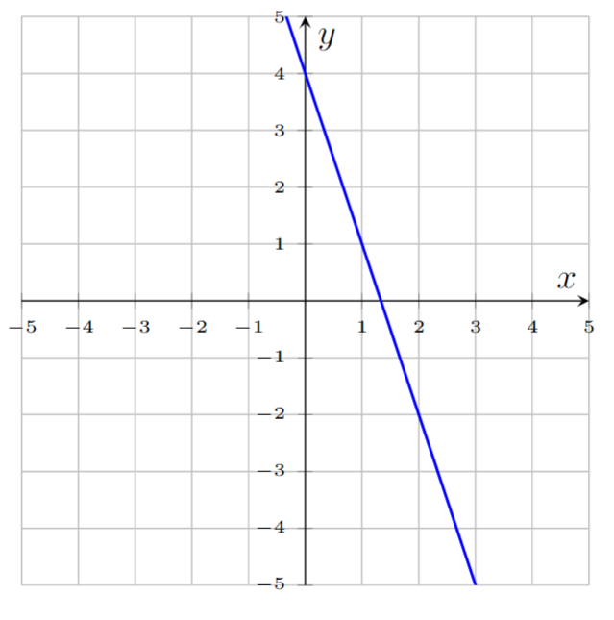
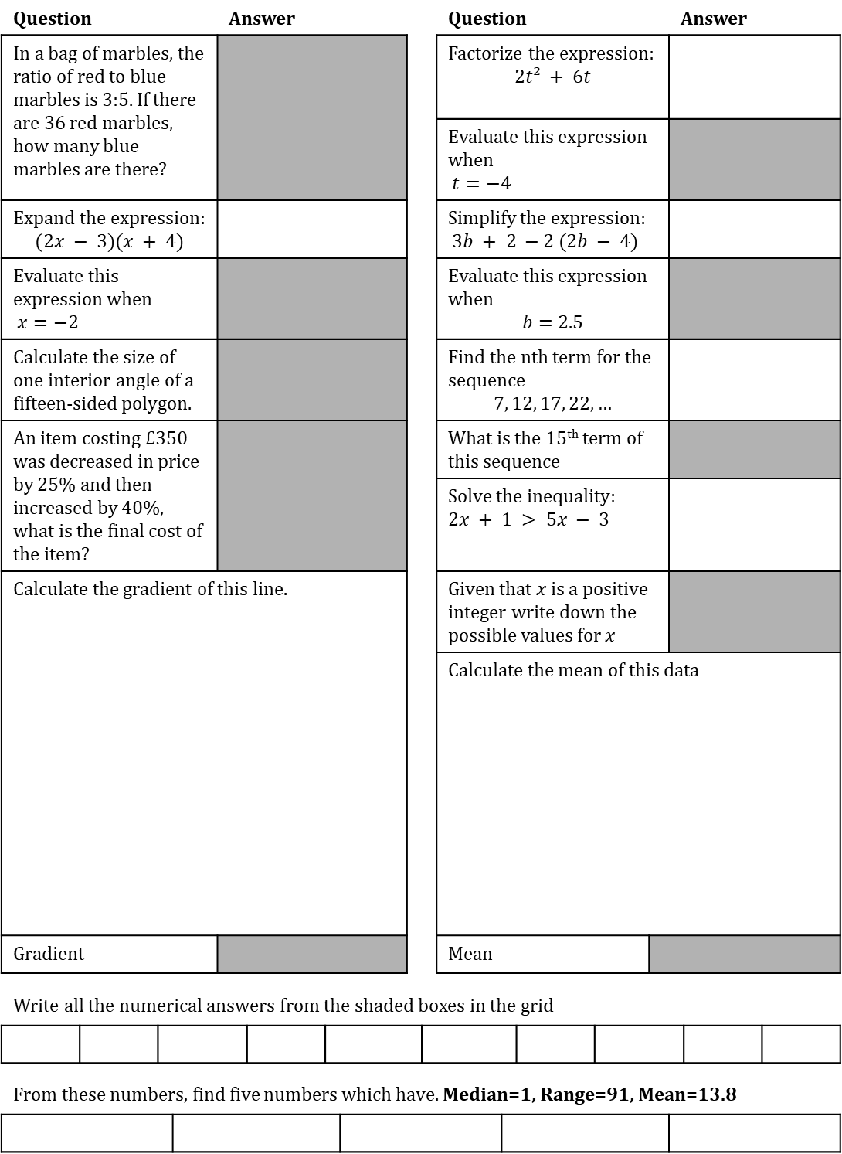
TASK
Date:
Question |  |  |  | Answer |  |  |  |  |  | Question |  |  |  | Answer | Answer
In a bag of marbles, the ratio of red to blue marbles is 3:5. If there are 36 red marbles, how many blue marbles are there? |  |  |  |  |  |  |  |  |  | Factorize the expression: $$2t² + 6t$$
 |  |  |  |  |  |  |  |  |  | Evaluate this expression when $t=−4$
Expand the expression: $$(2x − 3)(x + 4)$$ |  |  |  |  |  |  |  |  |  | Simplify the expression: $3b + 2 −2 (2b − 4)$
Evaluate this expression when $x=−2$ |  |  |  |  |  |  |  |  |  | Evaluate this expression when $$b=2.5$$
Calculate the size of one interior angle of a fifteen-sided polygon. |  |  |  |  |  |  |  |  |  | Find the nth term for the sequence $$7, 12, 17, 22, …$$
An item costing £350 was decreased in price by 25% and then increased by 40%, what is the final cost of the item? |  |  |  |  |  |  |  |  |  | What is the 15th term of this sequence
 |  |  |  |  |  |  |  |  |  | Solve the inequality: $2x + 1 > 5x − 3$
Calculate the gradient of this line. |  |  |  |  |  |  |  |  |  | Given that $x$ is a positive integer write down the possible values for $x$
 |  |  |  |  |  |  |  |  |  | Calculate the mean of this data
Gradient |  |  |  |  |  |  |  |  |  | Mean
Write all the numerical answers from the shaded boxes in the grid
From these numbers, find five numbers which have. Median=1, Range=91, Mean=13.8
Age | Frequency
13 | 5
14 | 3
15 | 2
16 | 4
17 | 3
18 | 3

Slide 3
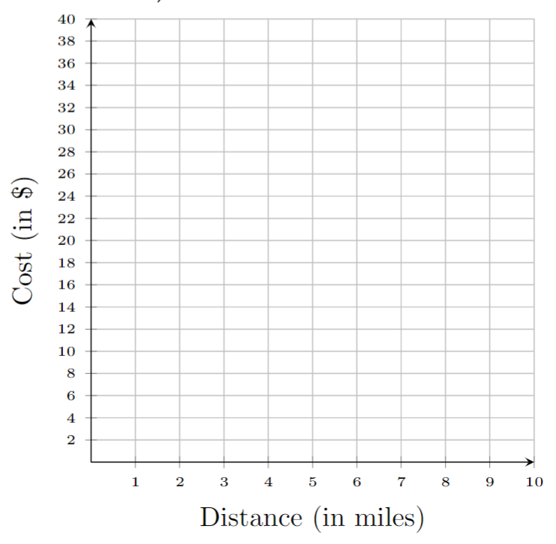
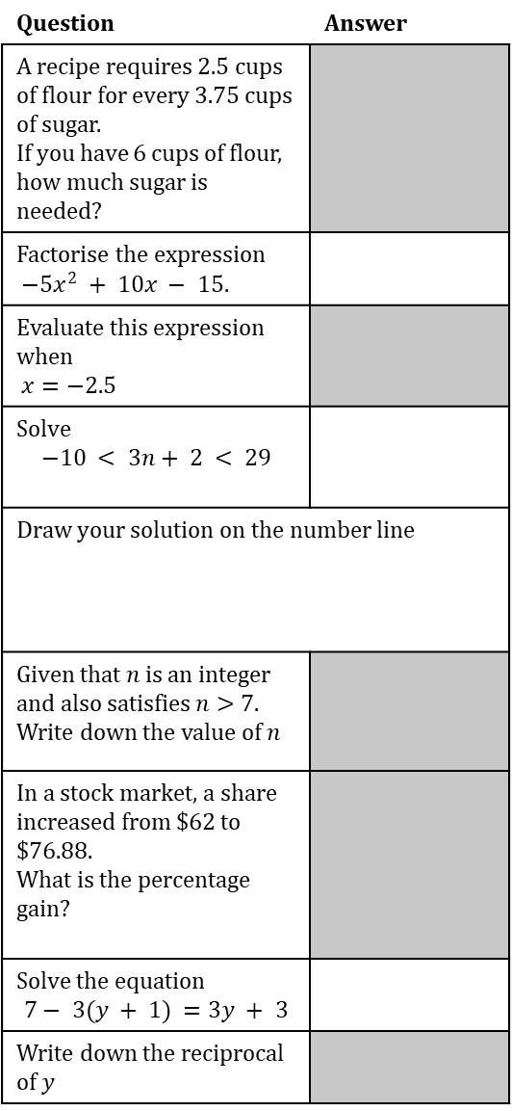
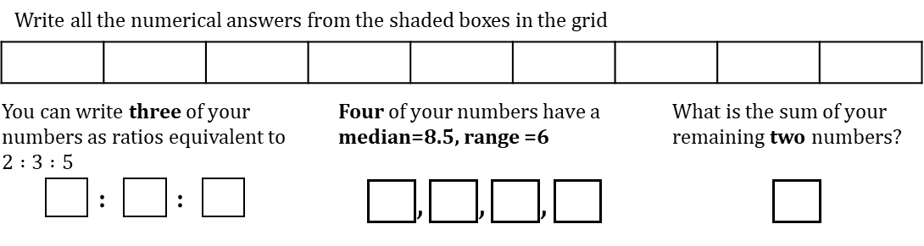
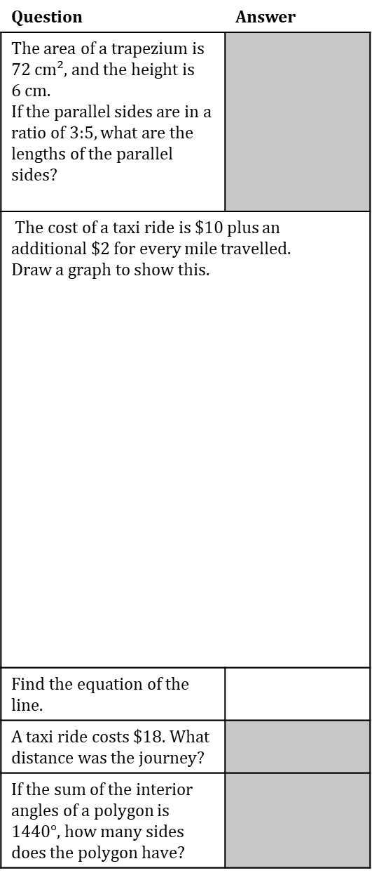
TASK
Date:
Question | Answer
A recipe requires 2.5 cups of flour for every 3.75 cups of sugar. If you have 6 cups of flour, how much sugar is needed?
Factorise the expression $−5x^{2} + 10x − 15.$
Evaluate this expression when $x=−2.5$
Solve $$−10 < 3n+ 2 < 29$$
Draw your solution on the number line
Given that $n$ is an integer and also satisfies $n>7.$ Write down the value of $n$
In a stock market, a share increased from $62 to $76.88. What is the percentage gain?
Solve the equation $$7− 3(y + 1) =3y + 3$$
Write down the reciprocal of $y$
Question | Answer
The area of a trapezium is 72 cm², and the height is 6 cm. If the parallel sides are in a ratio of 3:5, what are the lengths of the parallel sides?
The cost of a taxi ride is $10 plus an additional $2 for every mile travelled. Draw a graph to show this.
Find the equation of the line.
A taxi ride costs $18. What distance was the journey?
If the sum of the interior angles of a polygon is $1440°$, how many sides does the polygon have?
Write all the numerical answers from the shaded boxes in the grid
You can write three of your numbers as ratios equivalent to $2 :3 :5$ $$\boxed{} : \boxed{} : \boxed{}$$ |  |  |  | Four of your numbers have a median=7, range =6 $$\boxed{},\boxed{},\boxed{},\boxed{}$$ | Four of your numbers have a median=8.5, range =6 $$\boxed{},\boxed{},\boxed{},\boxed{}$$ |  |  |  |  | What is the sum of your remaining two numbers?

